Slide 1
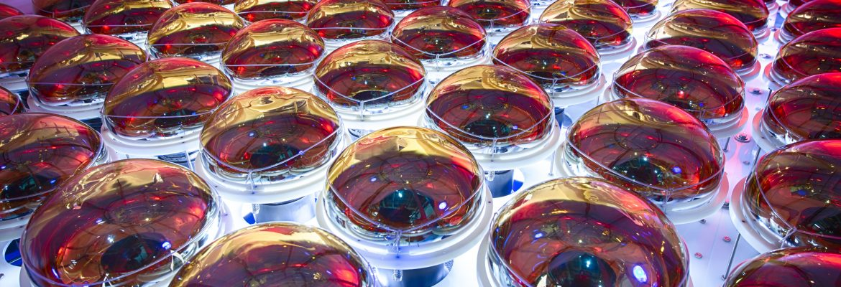


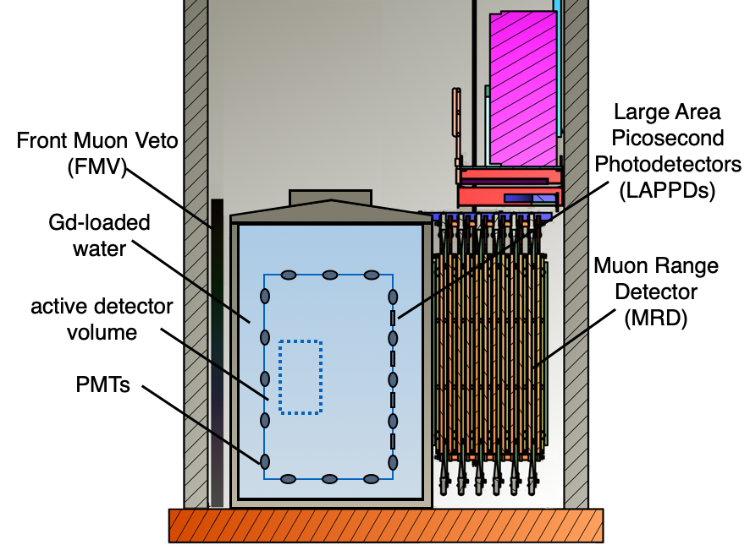
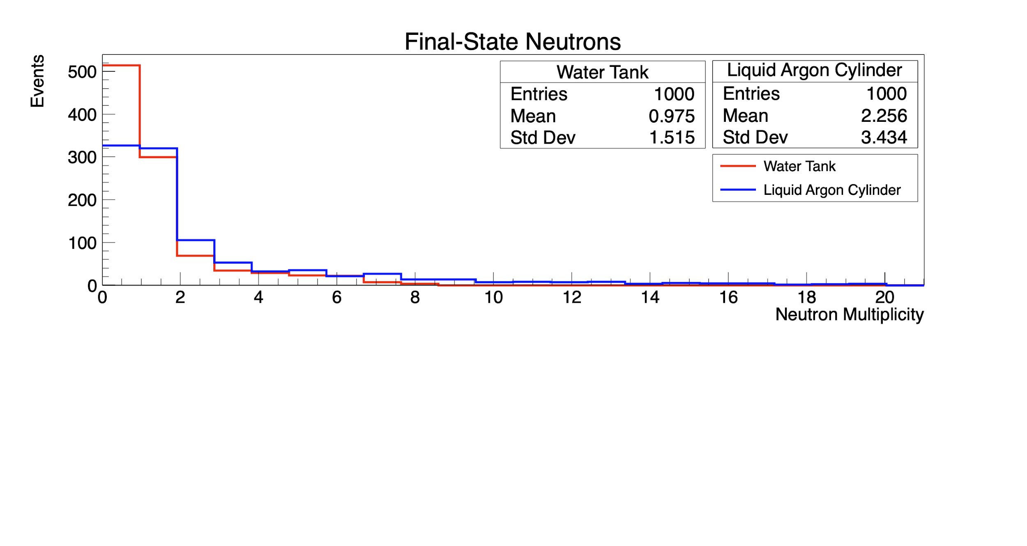
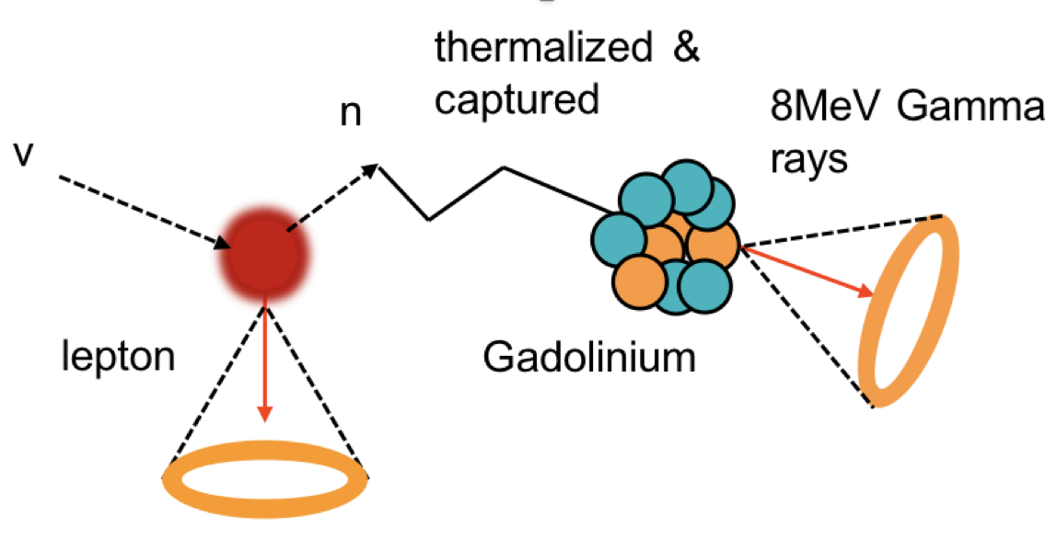
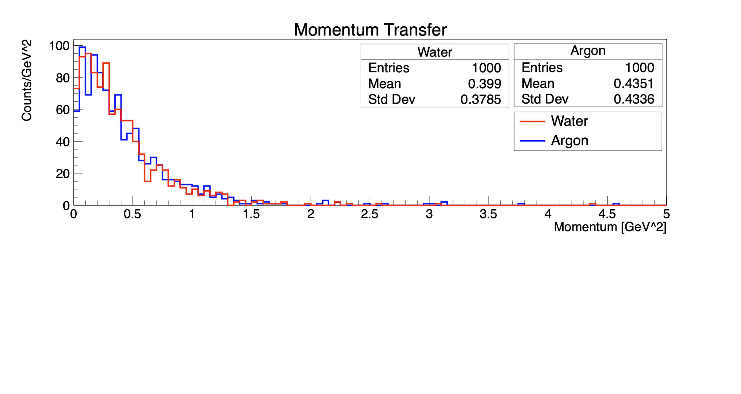
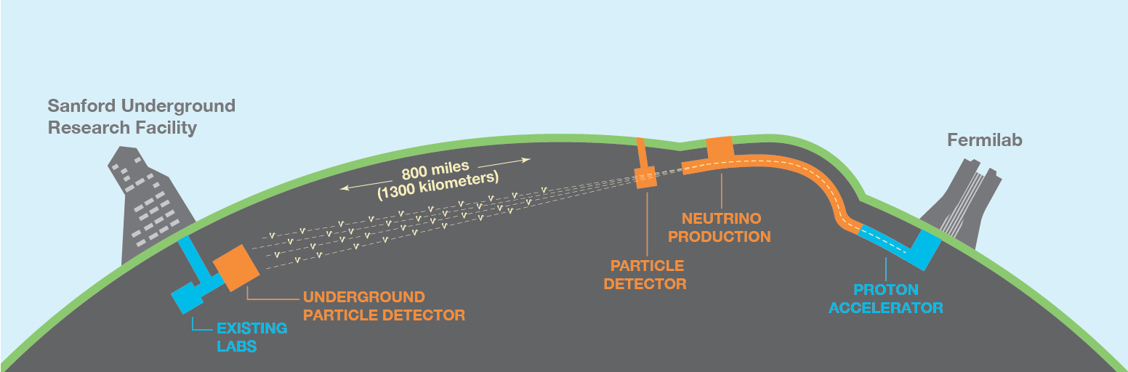
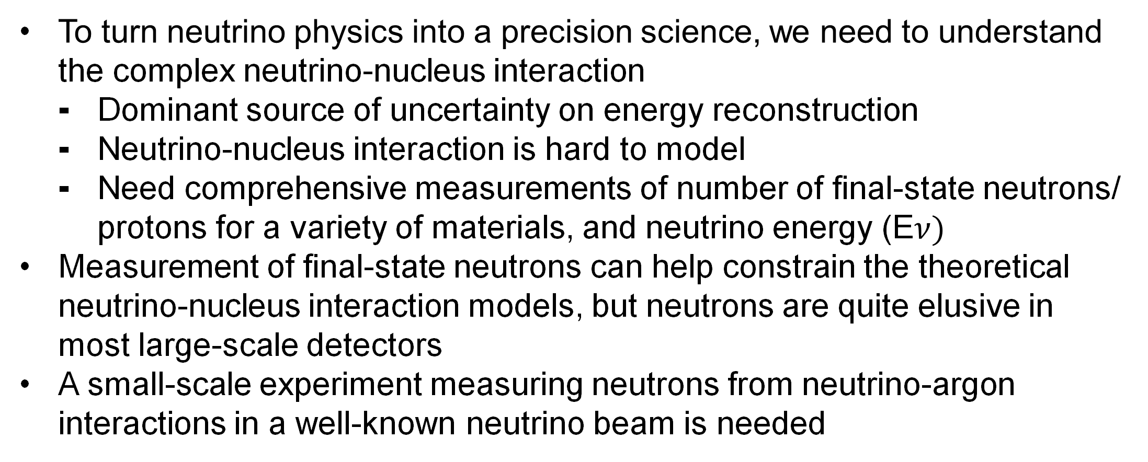

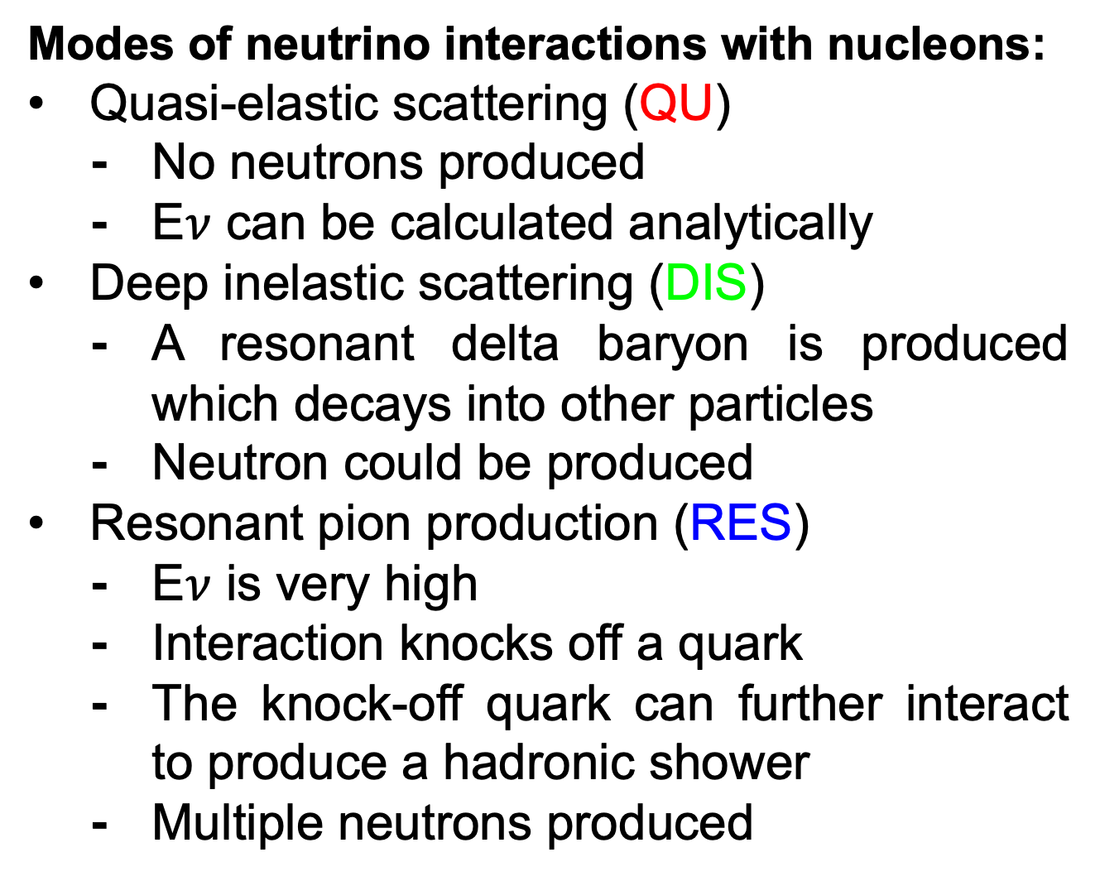
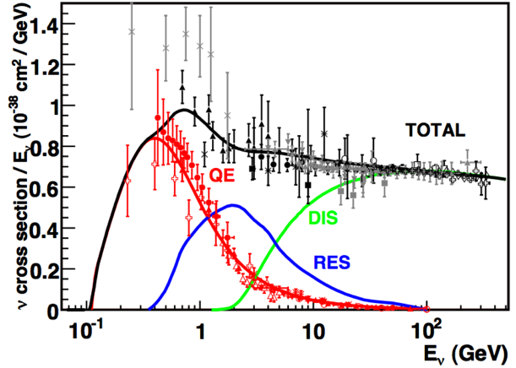
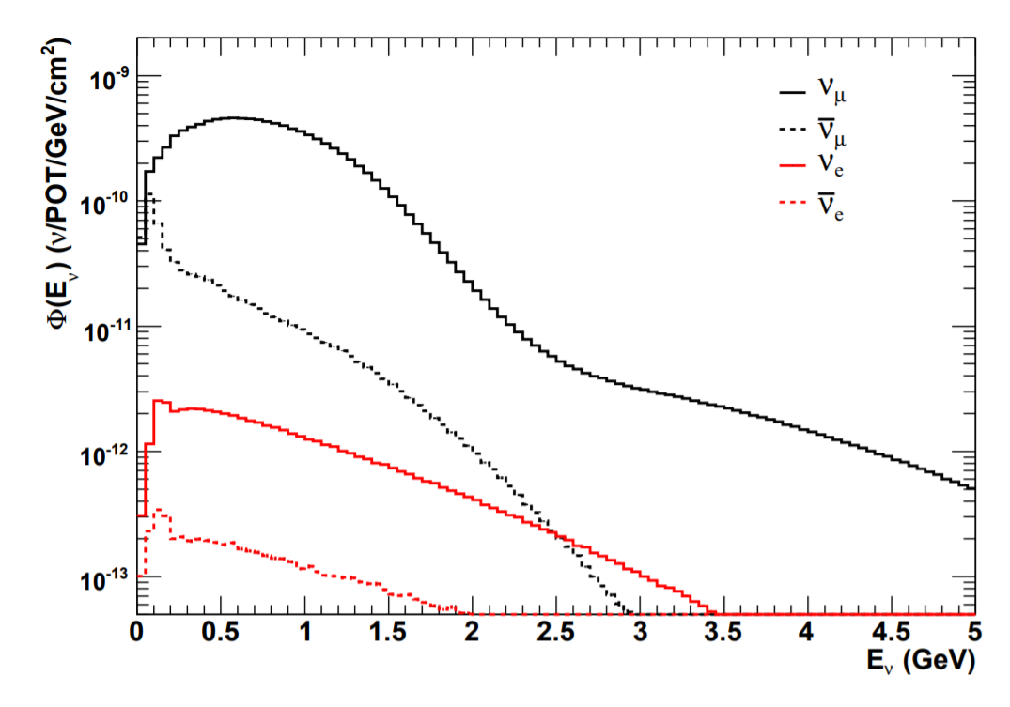
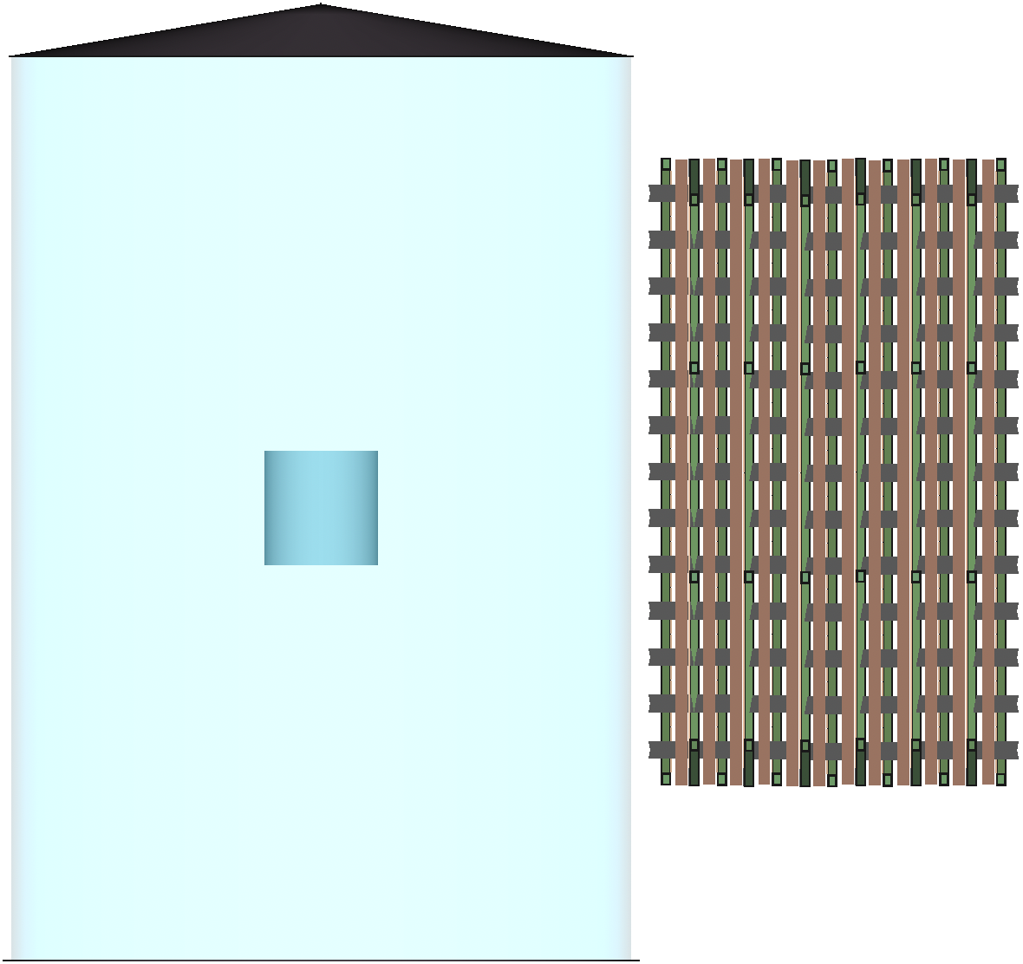
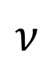
Feasibility Study For Neutrino-Argon Interaction Measurement in ANNIE
Noah Everett, Dr. Jingbo Wang
Abstract
How can ANNIE help?
First Simulation Results
The Deep Underground Neutrino Experiment (DUNE) aims to measure the neutrino CP-violating phase and determine the mass ordering, using the Liquid Argon Time Projection Chamber (LArTPC) technology. These measurements rely on the precise reconstruction of the incoming neutrino energy. However, the nuclear effects on neutrino-nucleus interactions are not well understood in argon, which could affect the precision of the experiment. Of particular interest, the measurement of the number of final-state neutrons from neutrino interactions can help constrain the theoretical neutrino-nucleus interaction models. To study neutrino-argon interactions, we propose to use the currently existing Accelerator Neutrino Neutron Interaction Experiment (ANNIE) at the Booster Neutrino Beam (BNB) at Fermilab. ANNIE is currently a water-based neutrino detector but can be modified to study neutrino-argon interactions such as those in DUNE. A feasible experimental strategy is to deploy a liquid argon target at ANNIE's fiducial volume location.
ANNIE: Accelerator Neutrino Neutron
Interaction Experiment ^{[2]}
26-ton gadolinium-loaded water Cherenkov detector placed downstream of the Booster Neutrino Beam (BNB) at Fermilab
Measure the number of final-state neutrons from neutrino-nucleus interactions in water
Demonstrate the use of Gd-loaded water and fast-timing LAPPD photodetectors
How does ANNIE work?
Muon neutrino from BNB interacts with nucleus in target volume and stops in MRD
Neutrons produced (if any) are captured in gadolinium producing Cherenkov light
Using MRD and photodetector data, the energy and final-state neutrons can be reconstructed
ANNIE detector can be modified to study neutrino-argon interactions
Add a small liquid argon target into the fiducial volume
Install photodetectors inside the target which will be used to identify neutron interactions in target
Leptons and neutrons can be reconstructed using the existing ANNIE infrastructure
Default ANNIE Detector
GENIE Generator simulated 1000 neutrino-argon interactions in ANNIE’s main water tank and proposed liquid argon target. The following are preliminary results:
Motivation
The Deep Underground Neutrino Experiment (DUNE) is an upcoming US-based long-baseline experiment for neutrino science.
photosensors
Proposed ANNIE Detector
electronics racks
liquid argon dewar
Future Work
Preform simulations on other well-measured targets to verify the preliminary results for liquid argon target
Modify the ANNIE detector geometry used for GENIE Generator simulations to more closely represent the realistic experimental conditions:
Add an actual liquid argon dewar
Add photodetectors into the dewar
Optimize the size and location of the target
DUNE is the flagship experiment of the Department of Energy. It will send a neutrino beam from Fermilab in Illinois to Sanford Underground Research Facility in South Dakota ^{[1]}
Simulation of Neutrino-Argon Interactions
Ultimate Physics Goal
GENIE ^{[3]}, which stands for Generates Events for Neutrino Interaction Experiments, is a Monte Carlo event generator that is used by nearly all modern neutrino experiments. GENIE’s predictions serve as standard reference points for the neutrino community.
Use ANNIE’s official simulation software WCSim/RATPAC to propagate final-state particles to obtain detector responses
Run default ANNIE event reconstruction to count the number of neutrons and reconstruct the lepton kinematics
Number of neutrons knocked out of argon
?
Momentum transfer
GENIE Generator parameters:
GEOMETRY is modified by adding a cylindrical liquid argon volume at the center of the ANNIE water tank
TOP VOLUME is defined as the added liquid argon volume
FLUX FILES are pre-simulated for the BNB neutrino beam at Fermilab
CROSS-SECTIONS (xsec) are from precomputed data files. The xsec file contains approximations for different types of interactions between multiple neutrino flavors and isotopes, and at many energies
TUNE specifies the comprehensive model configuration the generator will use. The preliminary results used G18_10a_02_11a
Summary
Measuring the number of final-state neutrons from neutrino-argon interactions could help constrain the neutrino-nucleus interaction models, thus improving the energy reconstruction precision in DUNE
Existing ANNIE detector can be modified to study neutrino-argon interactions by adding a liquid argon target into the water tank
The first GENIE Generator simulation has been preformed, and more work is underway
Introduction to Neutrino Interactions
Neutrino Interaction Cross-Sections
ANNIE (BNB)
BNB Flux
Simulation Geometry
DUNE (LBNF)
References
liquid argon target
[1] http://www.dunescience.org
[2] A. Back et al., arXiv preprint arXiv:1707.08222, 2017.
[3] http://www.genie-mc.org
Neutrino-Nucleus Interaction
Acknowledgements
+
q
+
+
lepton
Gd-loaded water
+
+
Muon Range Detector (MRD)
This work is supported by the National Science Foundation: EPSCoR Research Infrastructure Improvement Track 4: EPSCoR Research Fellows
+
+
+
hadrons

Slide 2
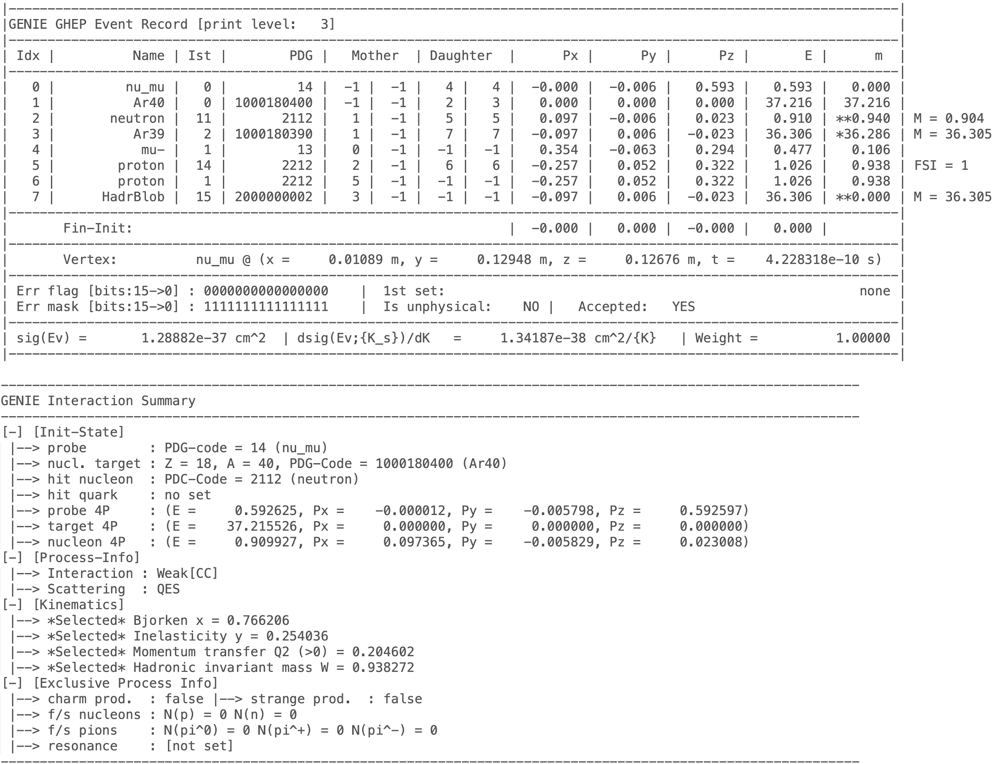
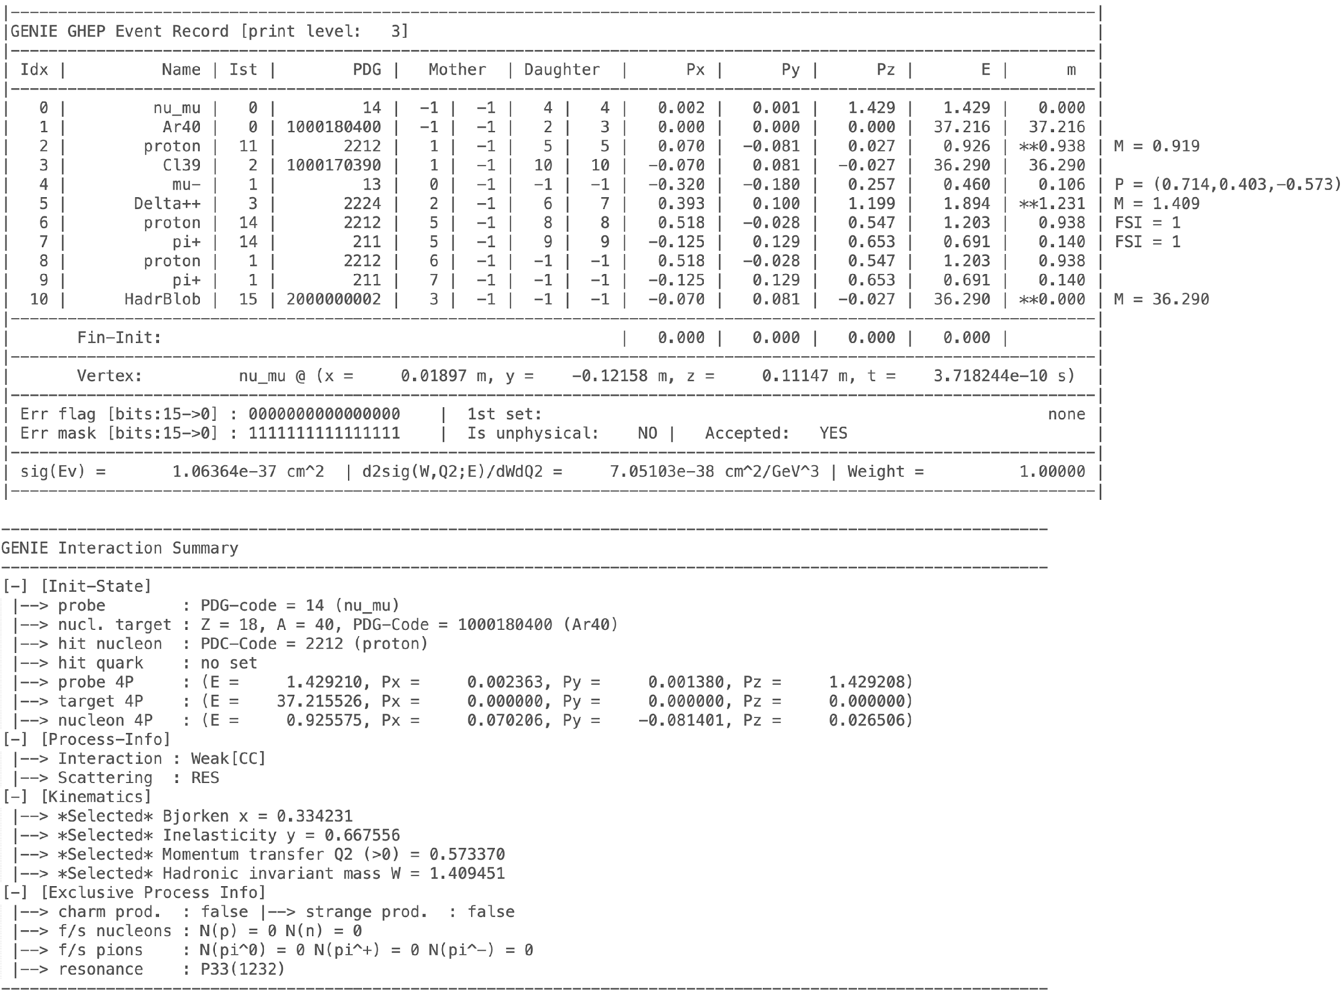
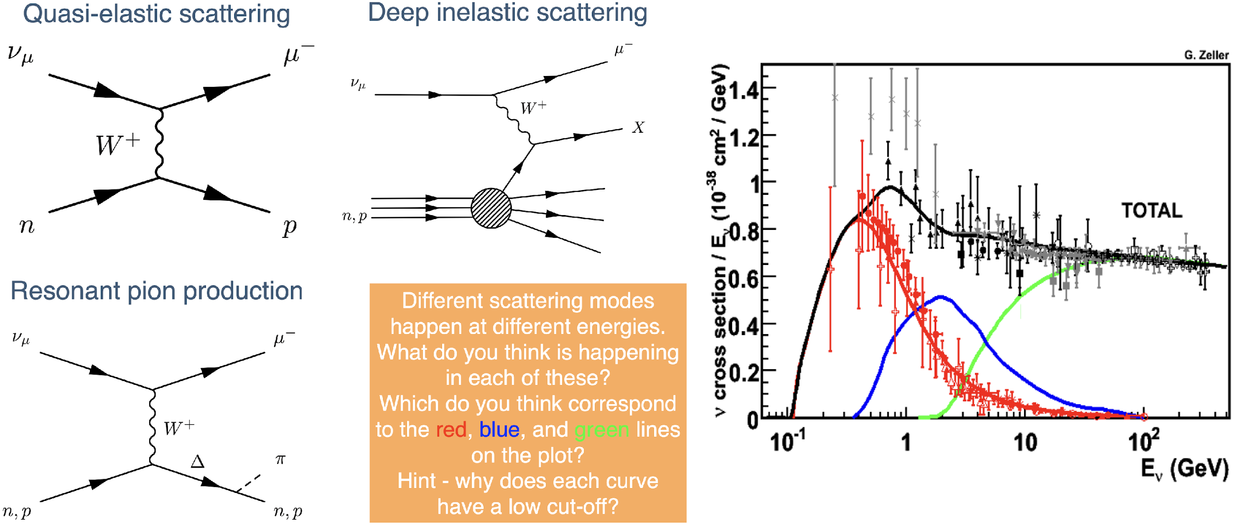


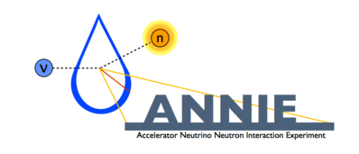
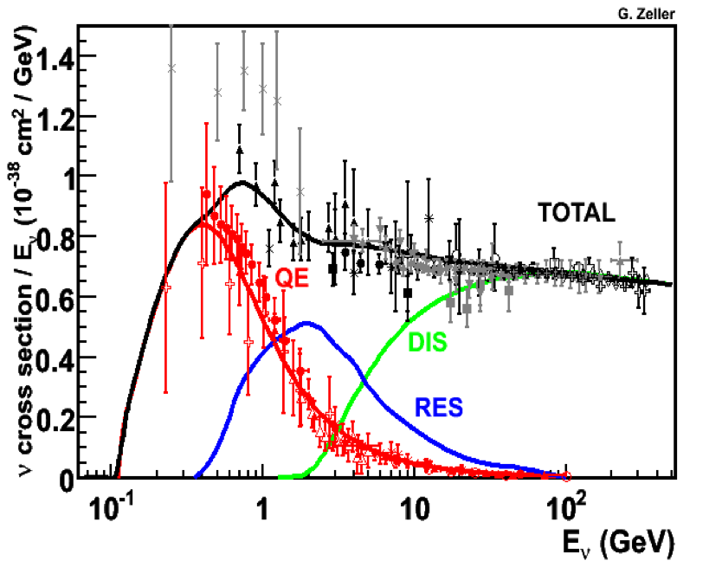
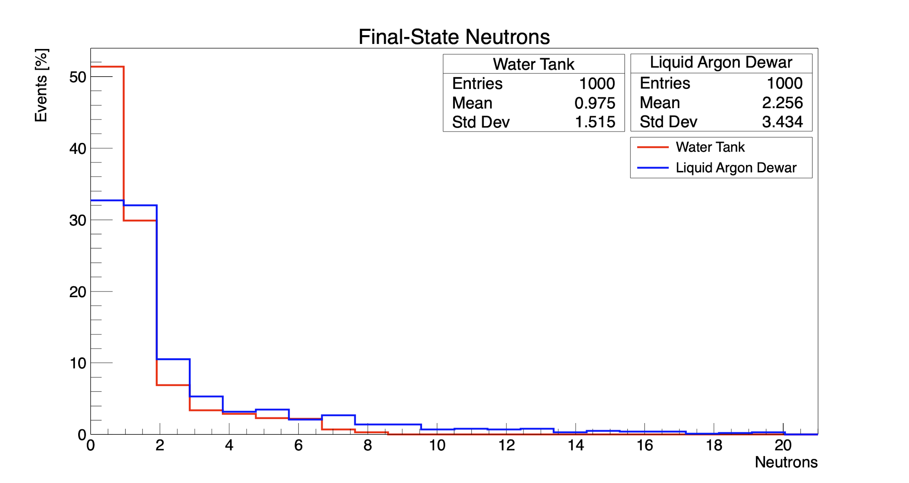
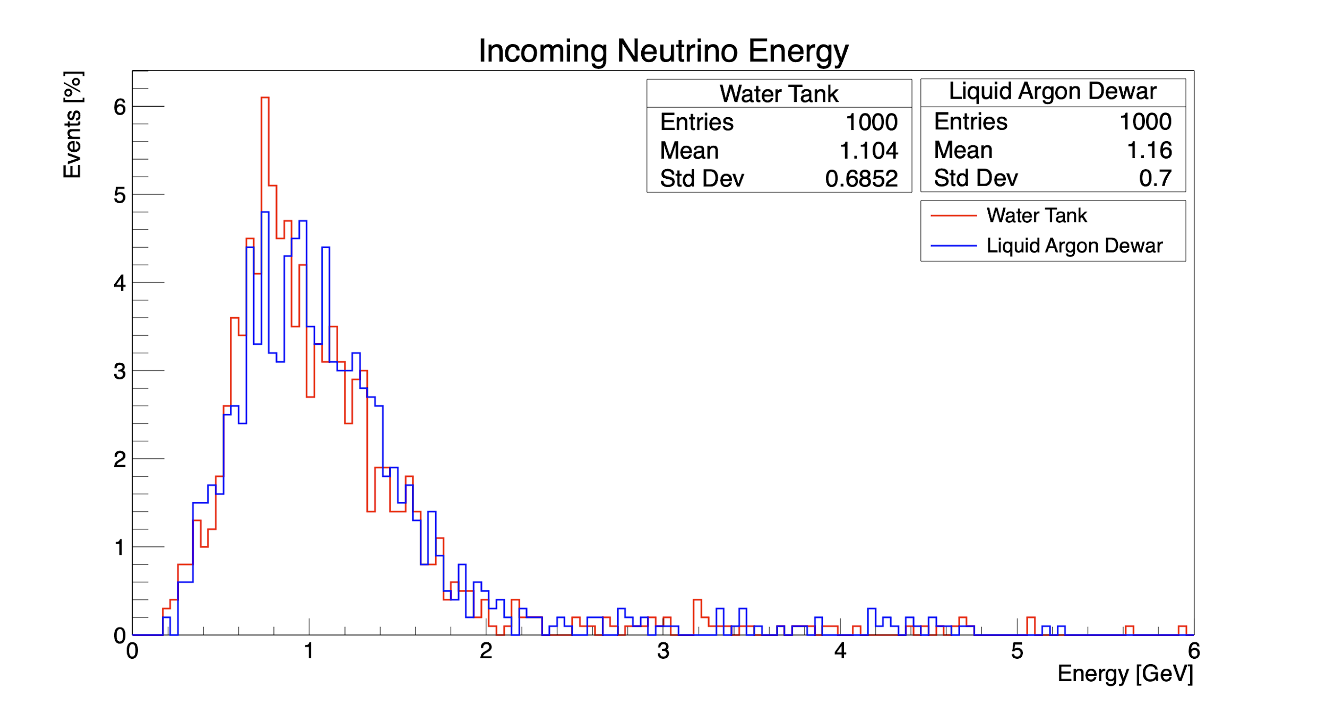
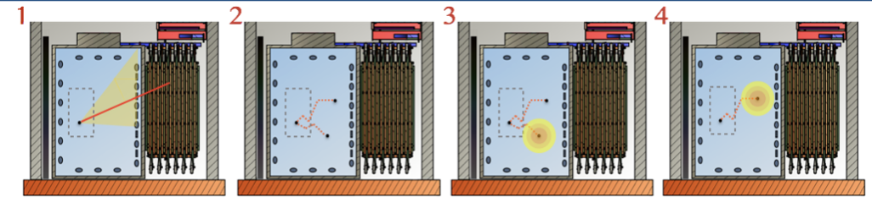
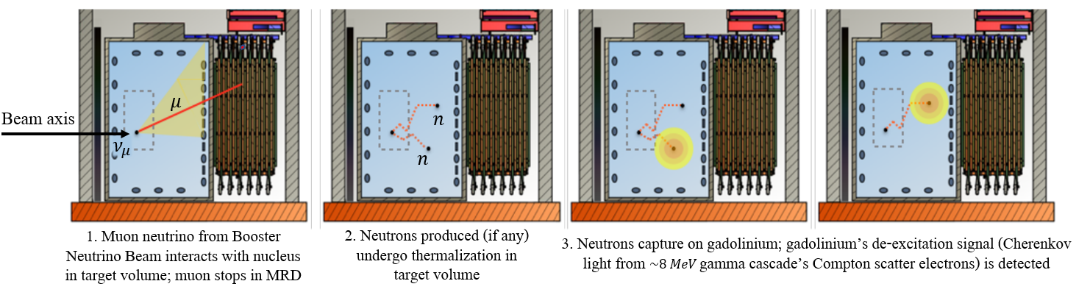
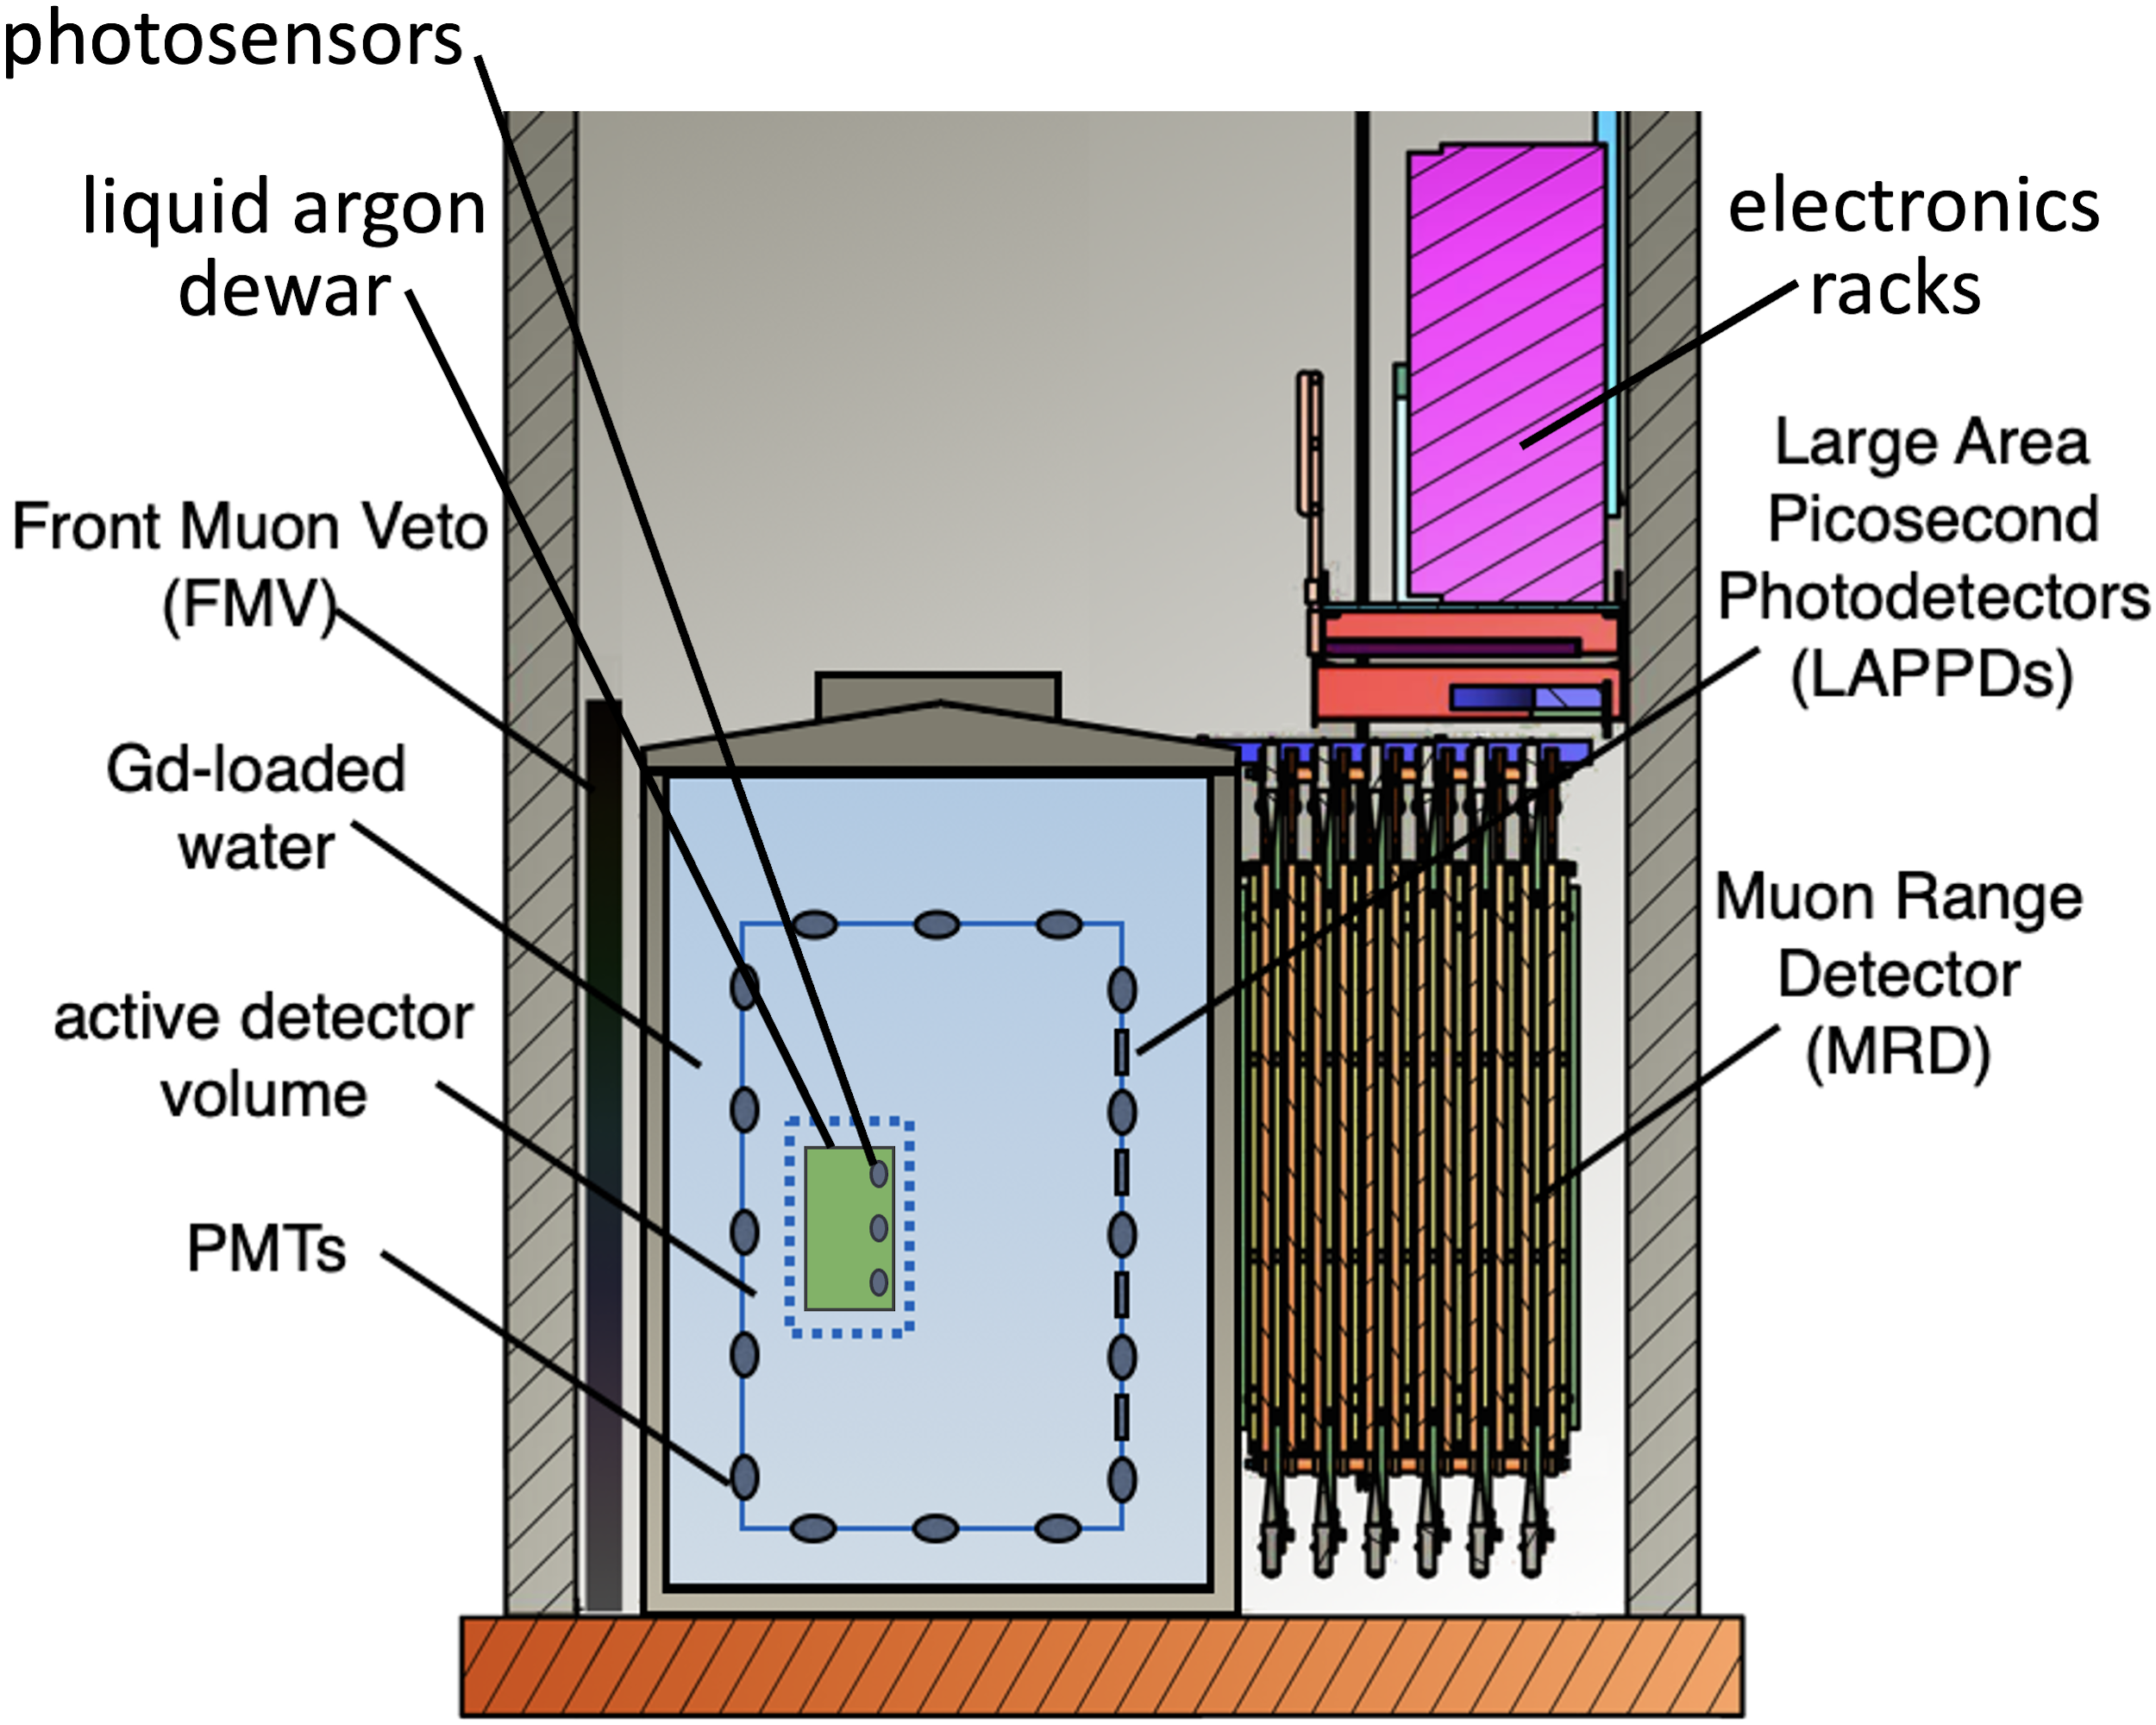
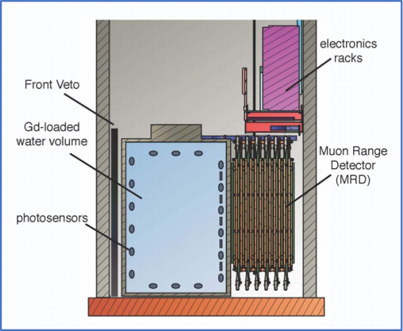
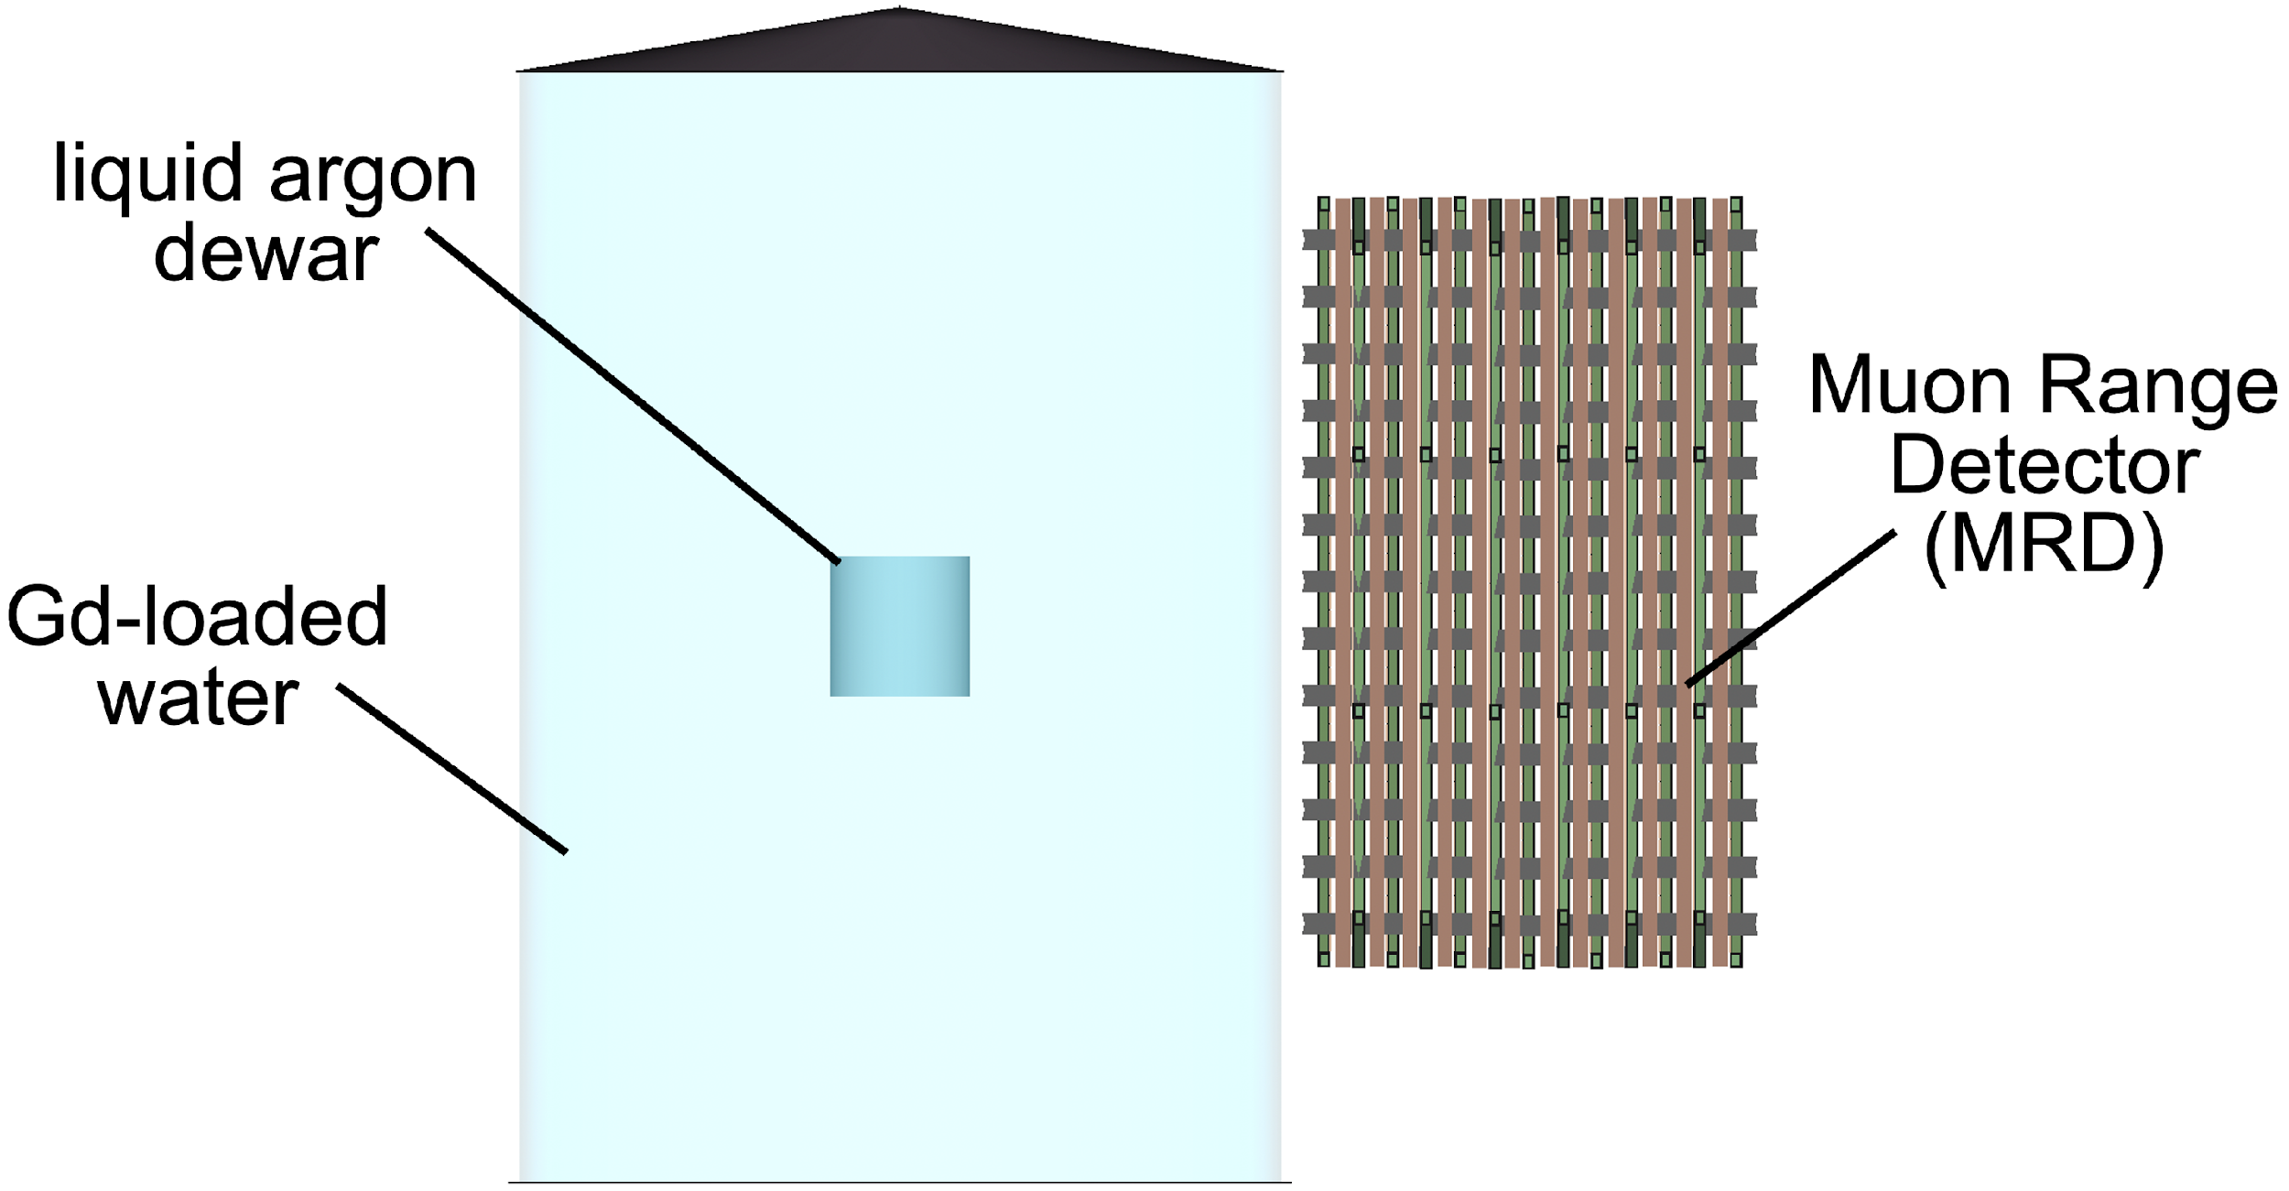
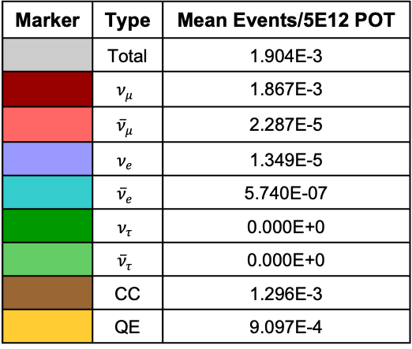
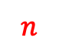
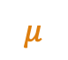
Backup GENIE figures:
Backup Logos:
Backup Neutrino Interaction figures:
Quasi-elastic scattering
Deep inelastic scattering
Resonant pion production
Backup BNB figures:
Simulated events in ANNIE
Electronics Rack
Marker | Type | Mean Events/5E12 POT
 | Total | 1.904E-3
 | $$ν_{μ}$$ | 1.867E-3
 | $${\overline{ν}}_{μ}$$ | 2.287E-5
 | $$ν_{e}$$ | 1.349E-5
 | $${\overline{ν}}_{e}$$ | 5.740E-07
 | $$ν_{τ}$$ | 0.000E+0
 | $${\overline{ν}}_{τ}$$ | 0.000E+0
 | CC | 1.296E-3
 | QE | 9.097E-4
Large Area Picosecond Photo Detectors (LAPPDs)
Front Muon Veto (FMV)
Gd-loaded Water
Muon Range Detector (MRD)
Fiducial Volume
$$μ$$
PMTs
$$n$$
photosensors
electronics racks
Backup ANNIE figures:
liquid argon dewar
photosensors
electronics racks
liquid argon dewar
liquid argon dewar
Muon Range Detector (MRD)
Gd-loaded water

